Slide 1
Accident Severity Prediction
A Case Study
By Ghita Benboubker

Slide 2
Outline
Motivation
Exploratory Data Analysis
Data Preprocessing
Modelling and Predictive Analysis
Conclusion & Future Work

Slide 3
Motivation
Predicting accident severity enables us to:
Estimate human injuries and losses
Estimate material damages
Enable emergency responders to respond quickly and provide appropriate care
Avoid traffic congestions by quickly attending to the accident

Slide 4
Exploratory Data Analysis
Target variable
Four types of predictors:
Time-related attributes
Location-related attributes
Weather-related attribute
Miscellaneous

Slide 5
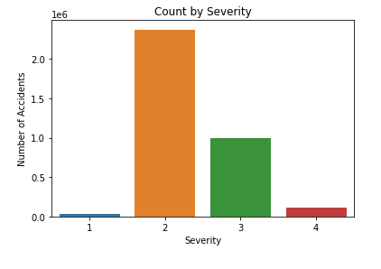
Target variable
Unbalanced such that most accident occurrences have severity 2 and 3.

Slide 6
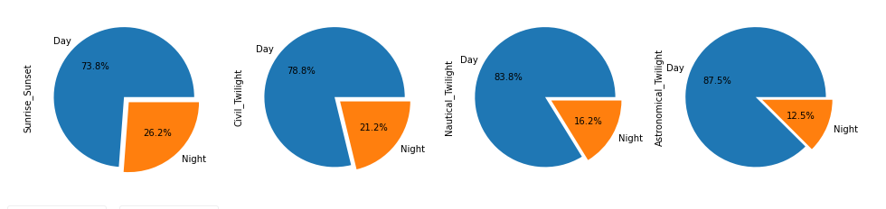
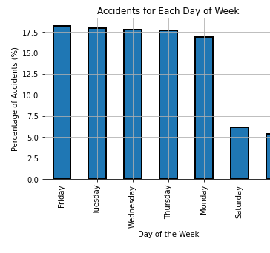
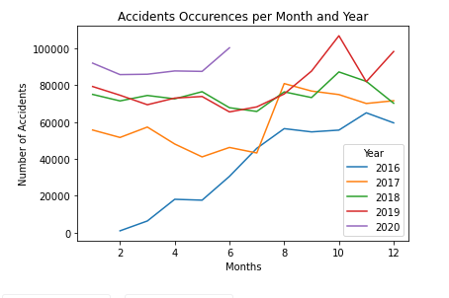
Time-Related Predictors

Slide 7
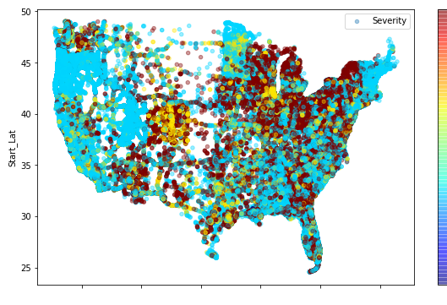
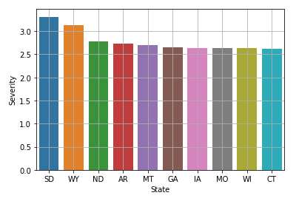
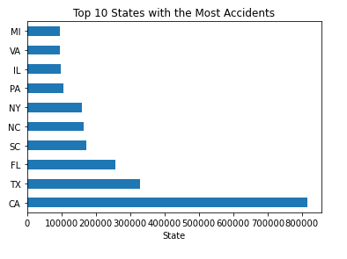
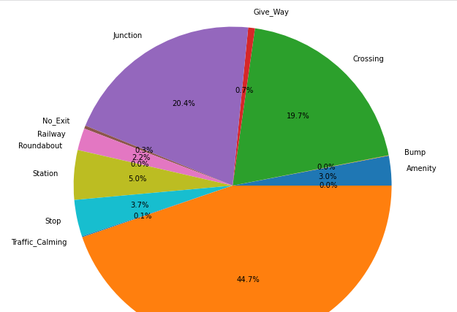
Location-Related Predictors

Slide 8
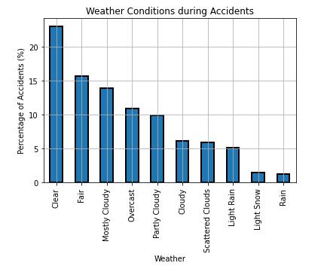
Weather-Related Predictor

Slide 9
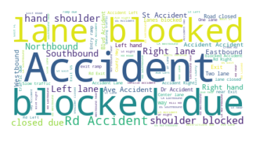
Word Cloud for Accident Description

Slide 10
Data Preprocessing
Dealing with missing data
Dealing with categorial variables (one hot encoding)
Investigation correlation

Slide 11
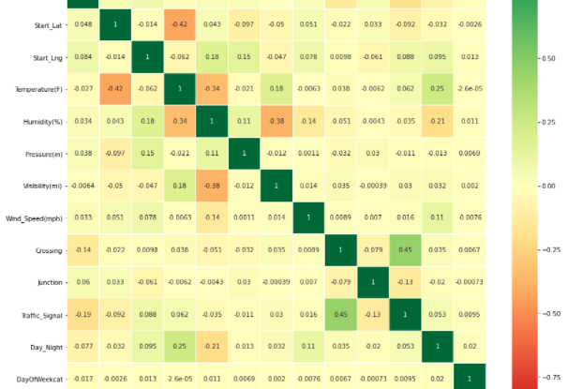
Correlation

Slide 12
Modelling & Prediction
Algorithm | Jaccard Score | F1-Score | Log Loss
Decision Trees | 51% | 54.5%
Logistic Regression | 51% | 54.9% | 72.9%

Slide 13
Conclusion & Future Work
Based on the accuracy metrics, the best classifier is
As further work, we can predict the duration of an accident based on its severity to improve traffic congestions

